Slide 1
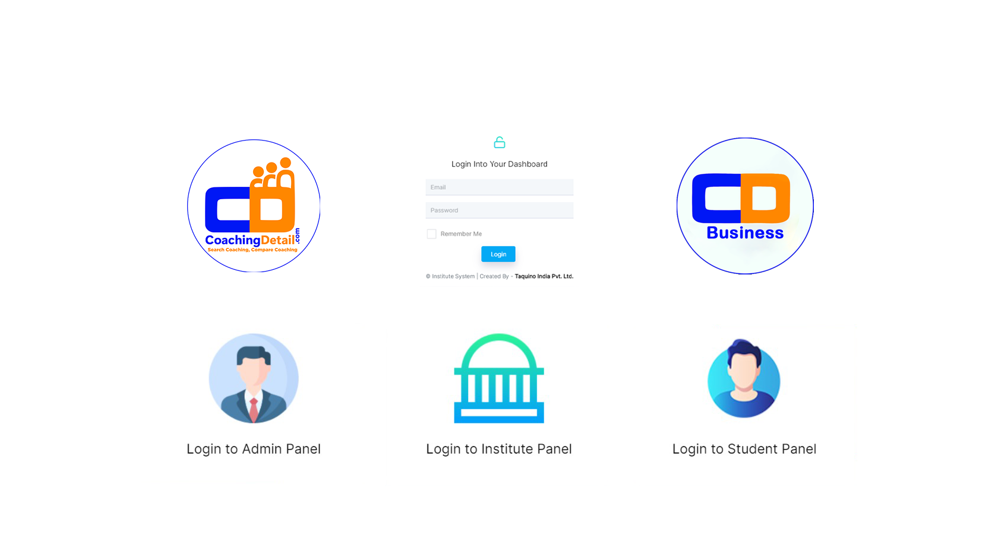


Welcome to CD Business
An Institute Management System that seamlessly manages and stores your data
Choose your portal: Admin, Institute or Student login options.

Slide 2
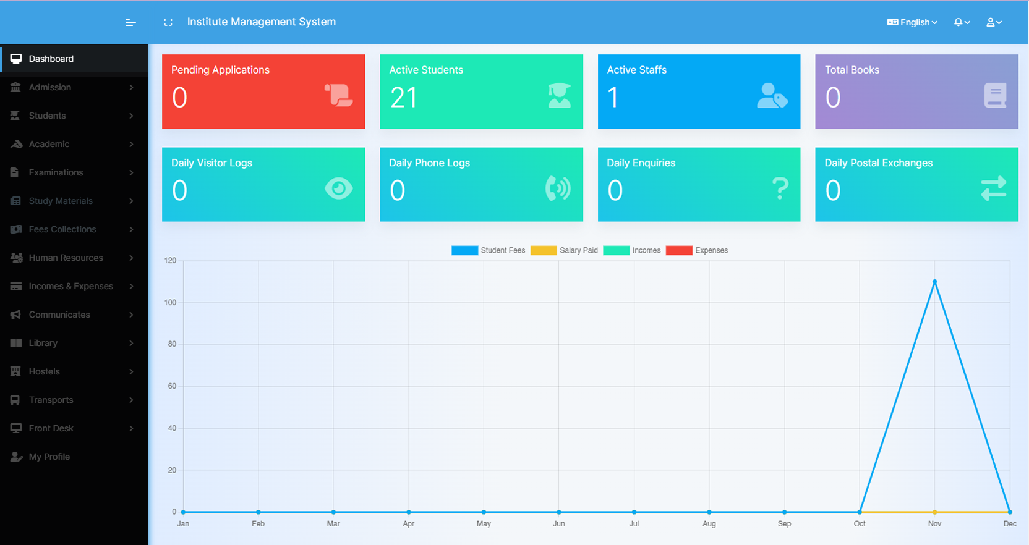
Navigate a detailed dashboard for comprehensive analytics

Slide 3
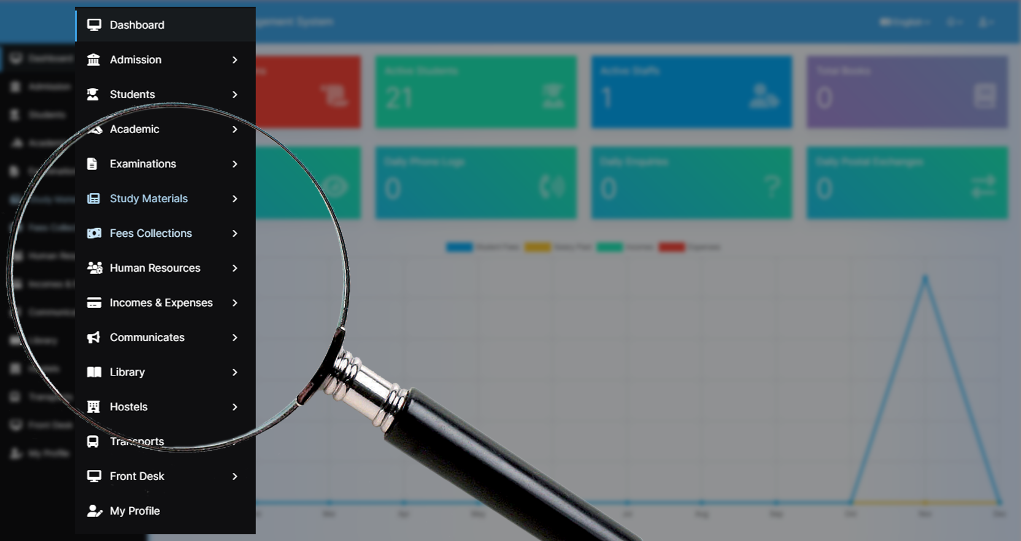
Explore features with a user-friendly sidebar

Slide 4
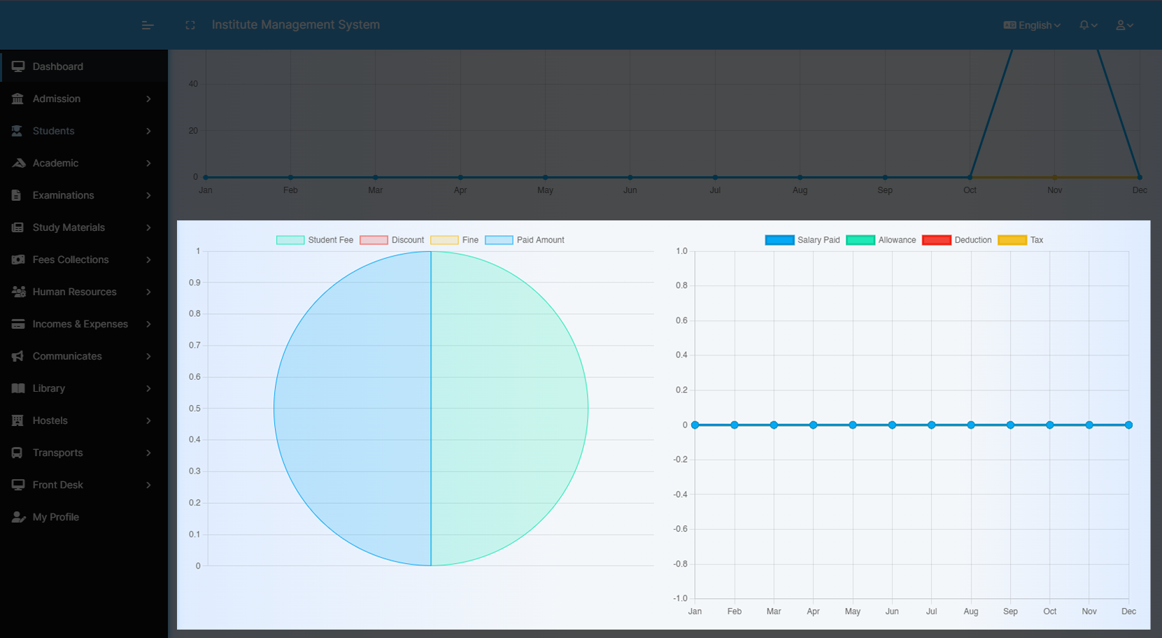
View Data insights using Graphs and Pie Charts

Slide 5
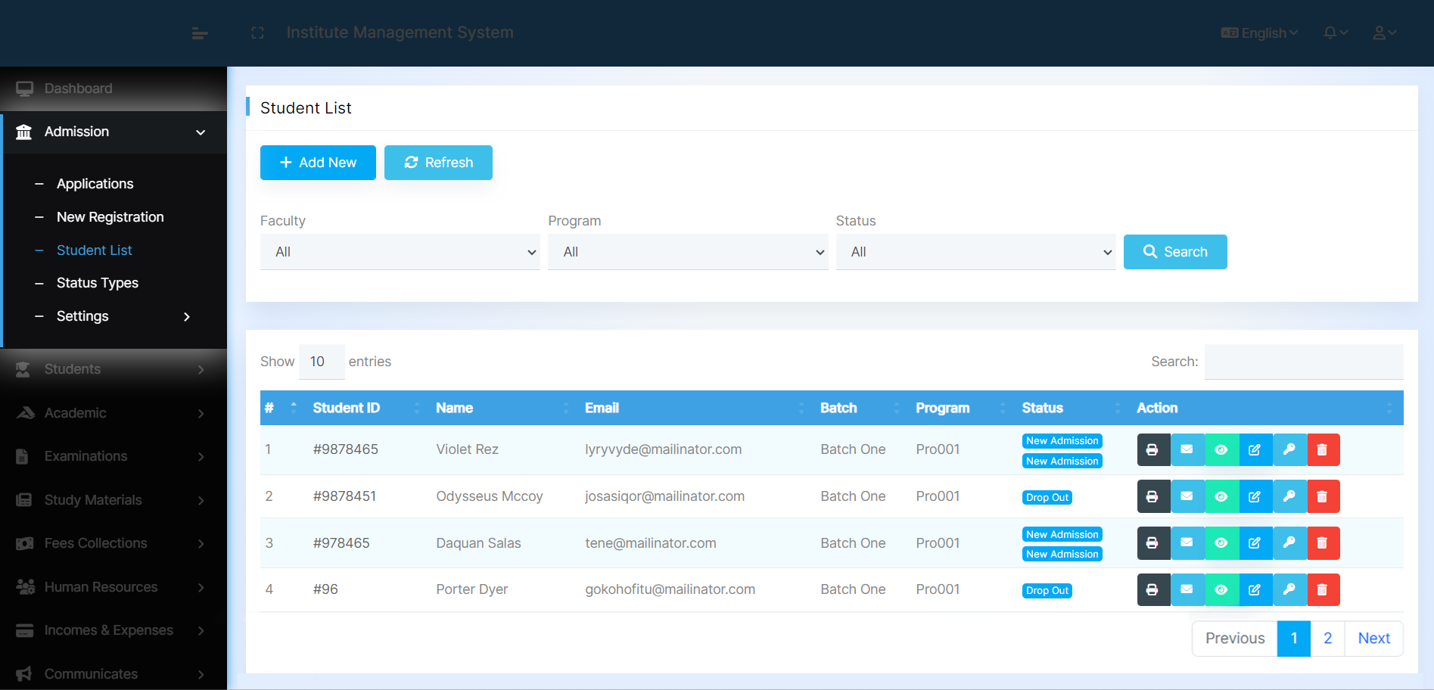
Quickly review the entire Student List

Slide 6
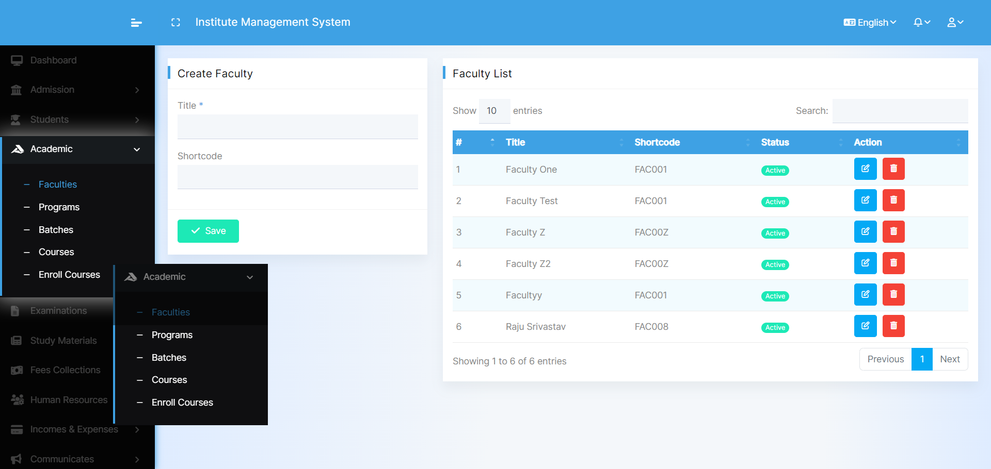
View all Faculty details in a simple list
Create & Manage your Programs, Batches, and Courses effortlessly

Slide 7
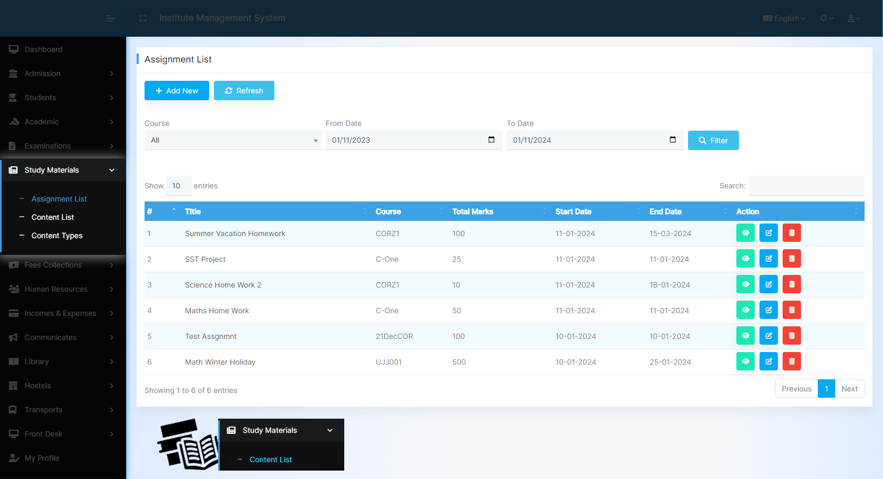
Create, Manage & Monitor Student Assignments
Add Study Material for Students

Slide 8
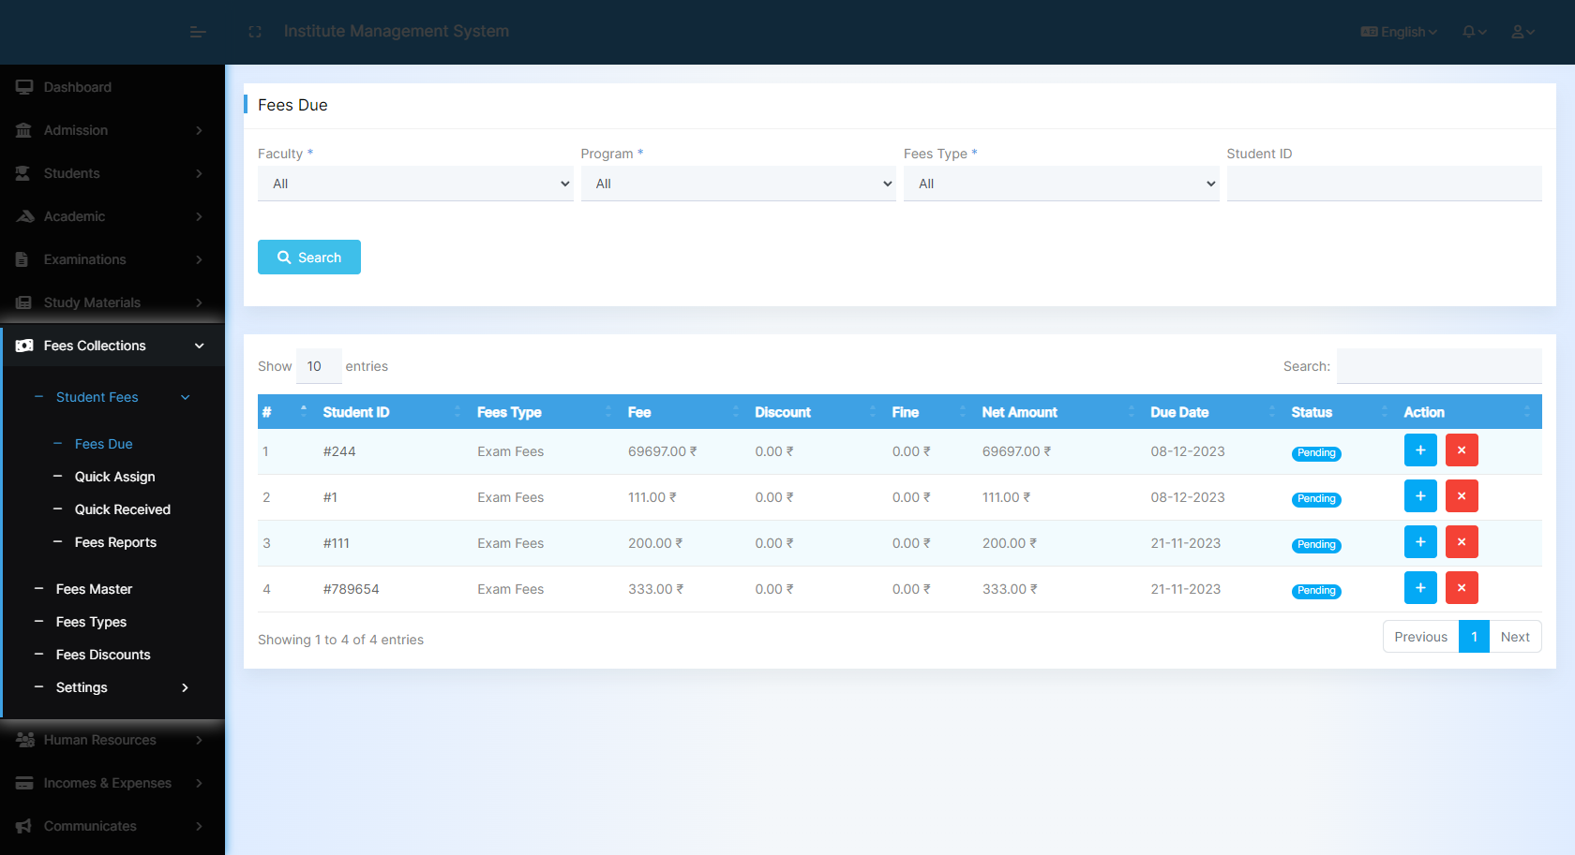
View and Manage Pending Student Fees

Slide 9
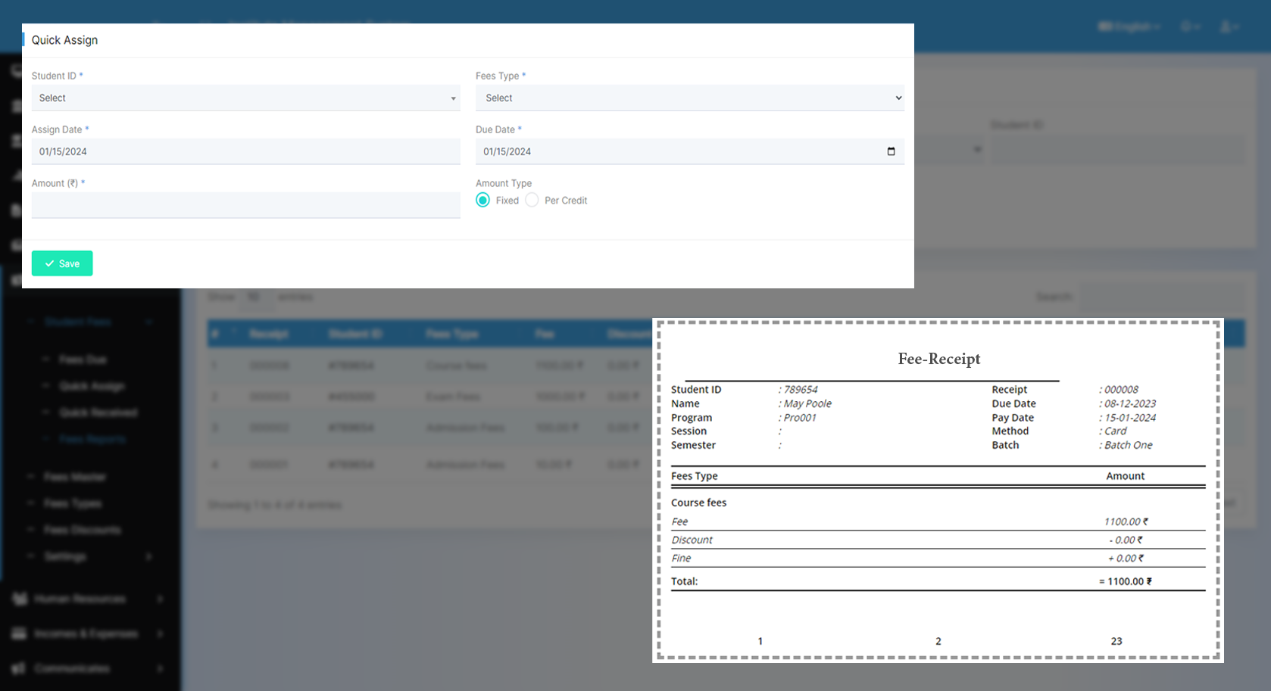
Effortlessly Assign Fees to Students
and Courses
Customize and Print
your own Fee Receipt

Slide 10
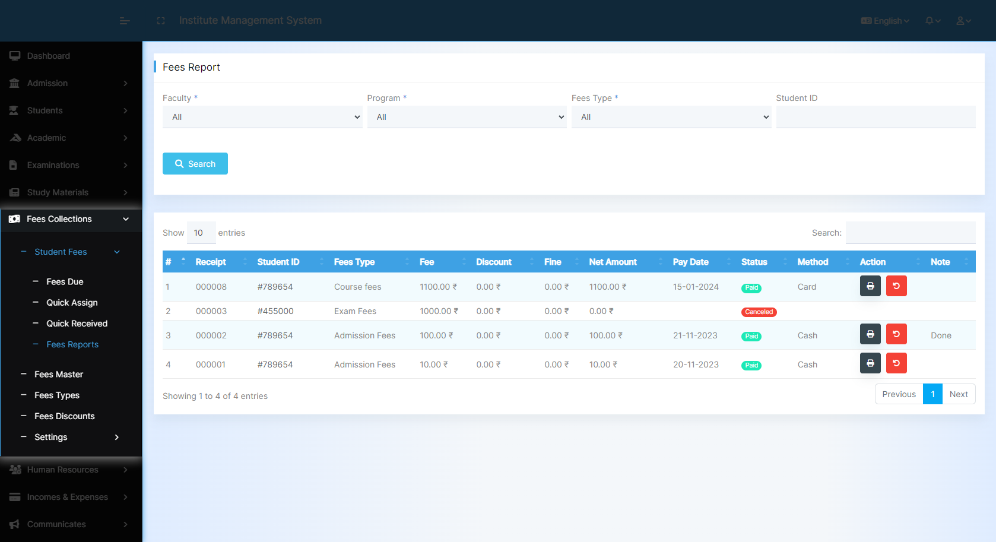
View and Manage Student Fee Details

Slide 11
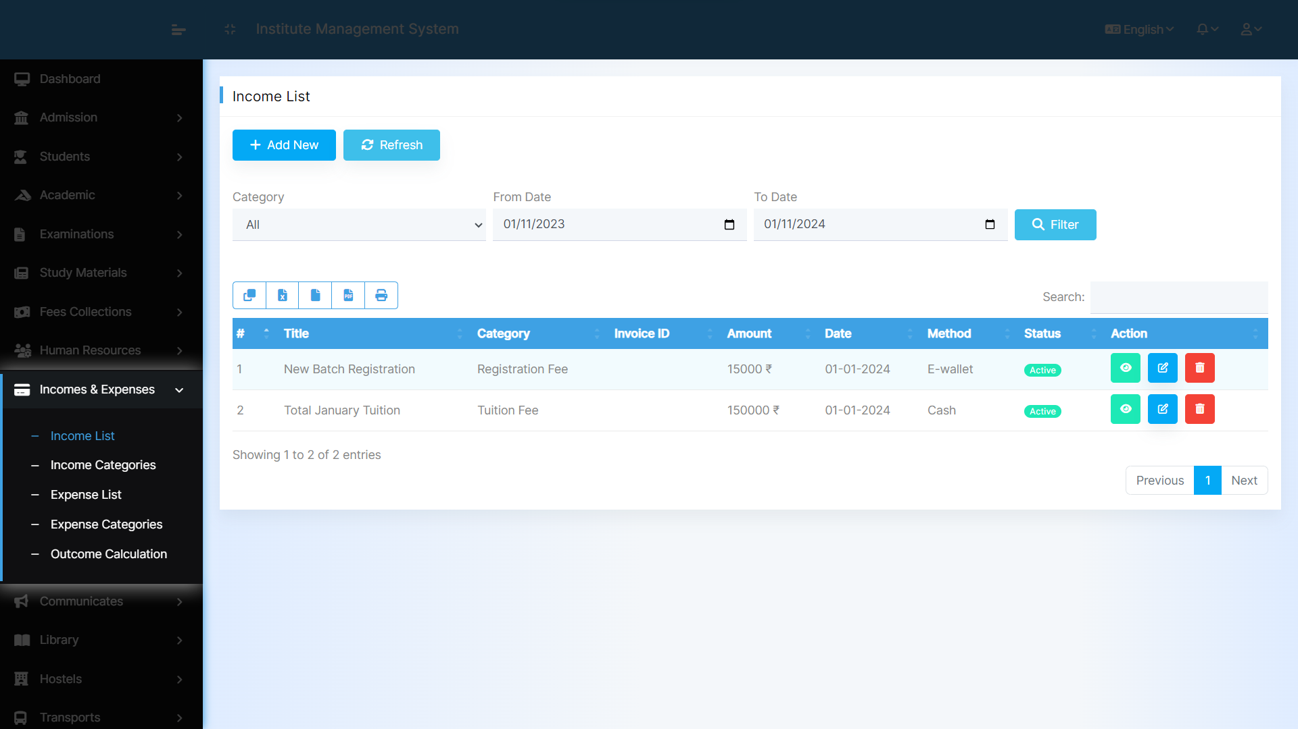
View and Examine Income Records

Slide 12
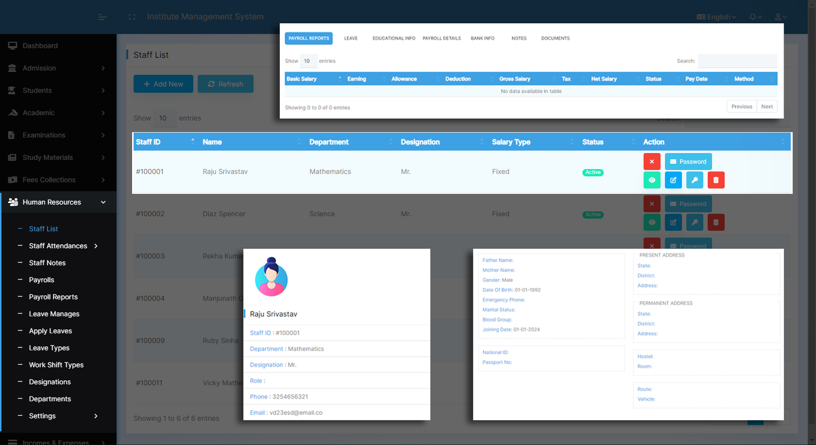
Organize and Document All Employee Details

Slide 13
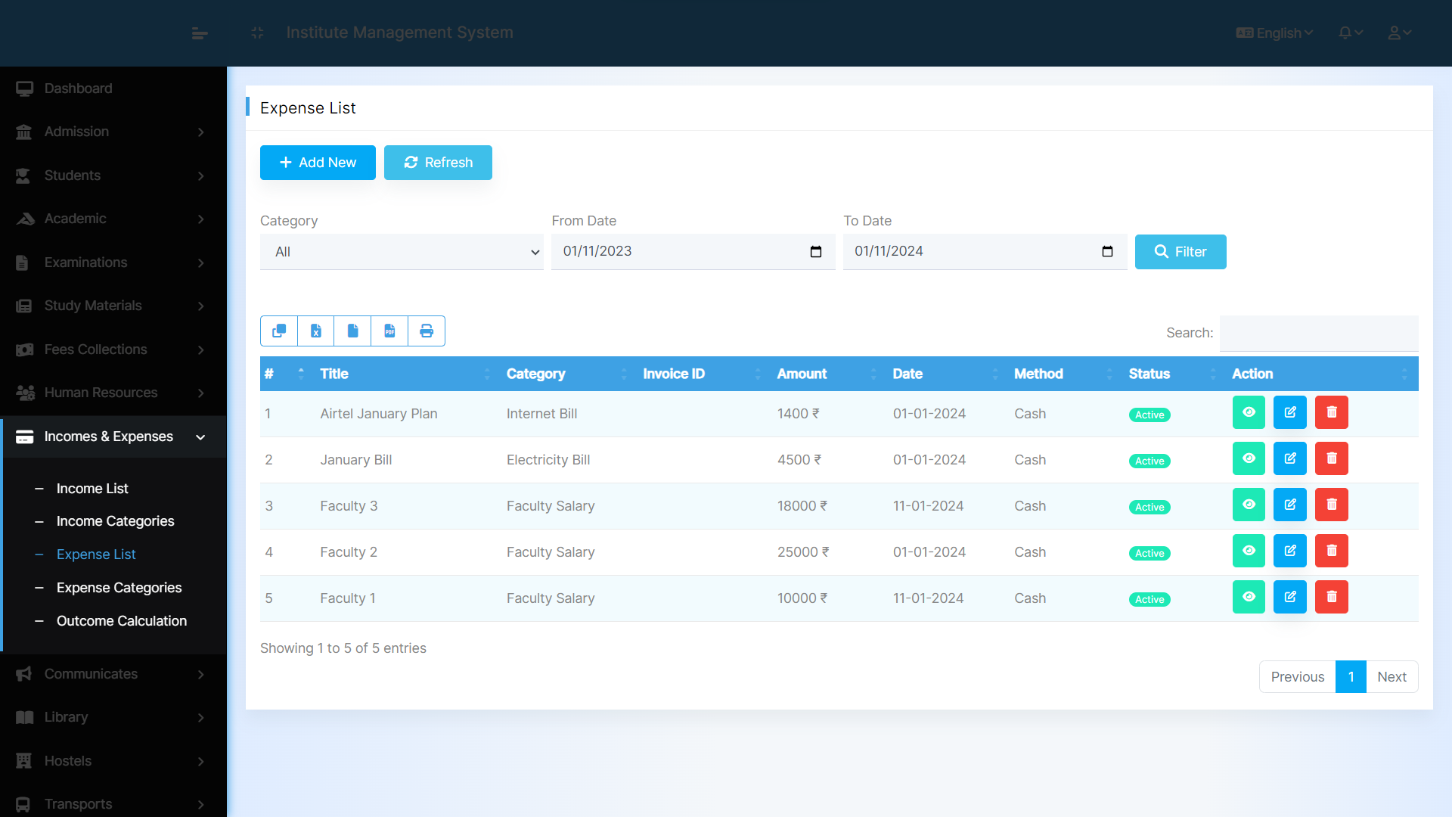
Review and Evaluate Expense Records

Slide 14
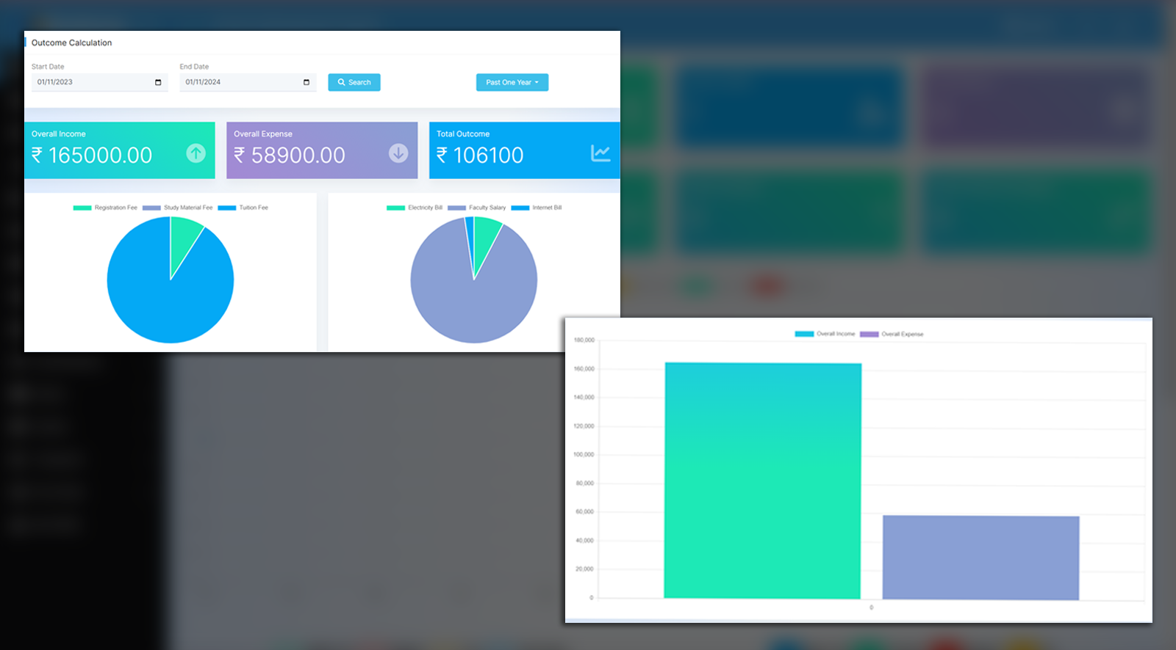
View and Scrutinize
Net Financial Outcome
Analyze using Graphs and Charts

Slide 15
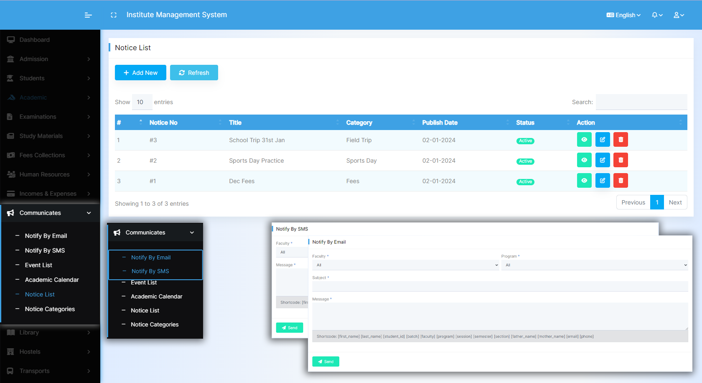
Create Events & Notices
Send Notices by Email and SMS

Slide 16
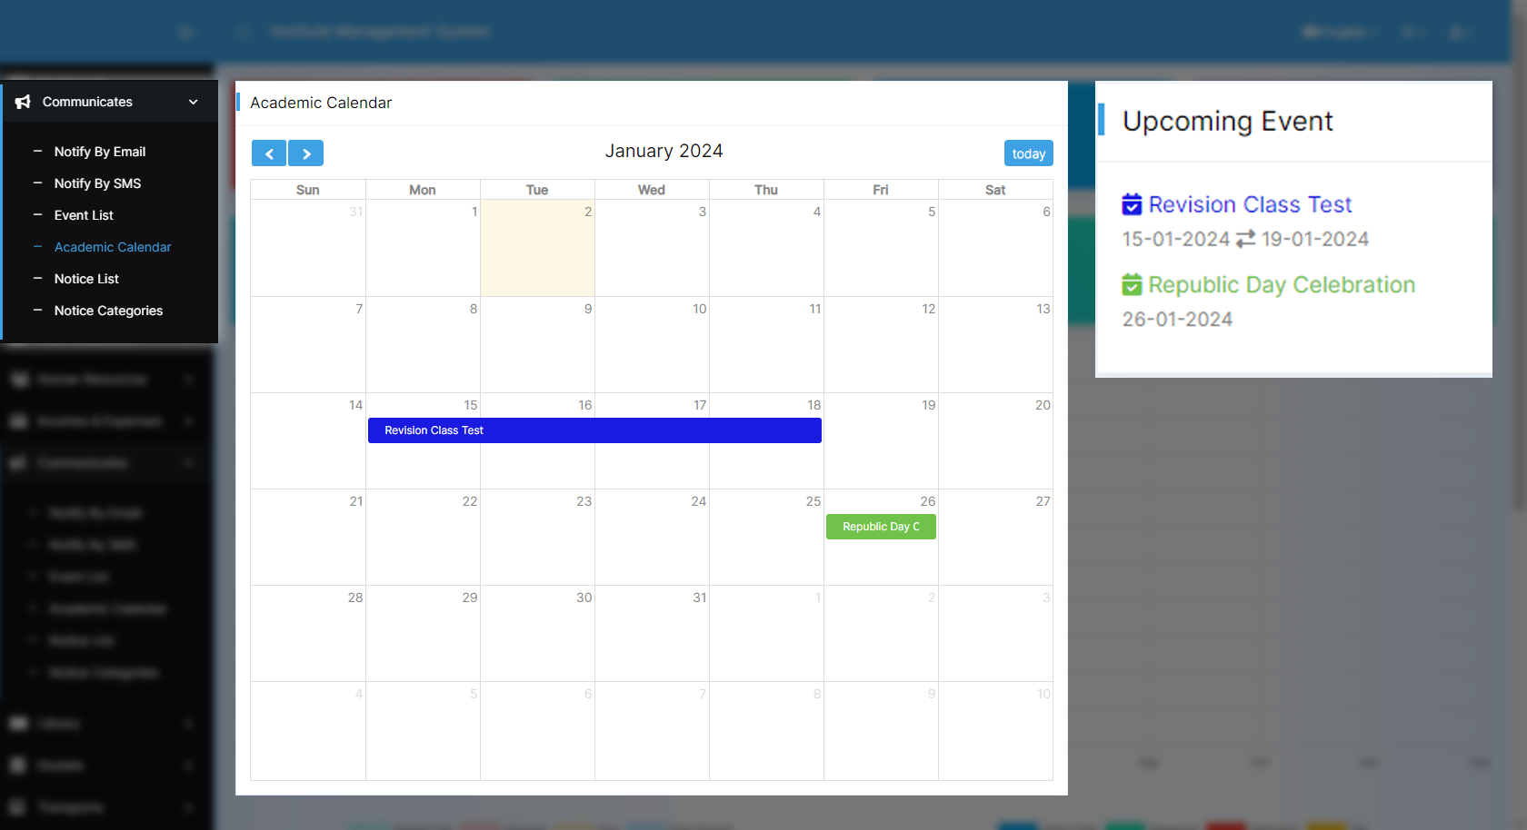
Effortlessly manage schedules with a
user-friendly
Academic Calendar

Slide 17
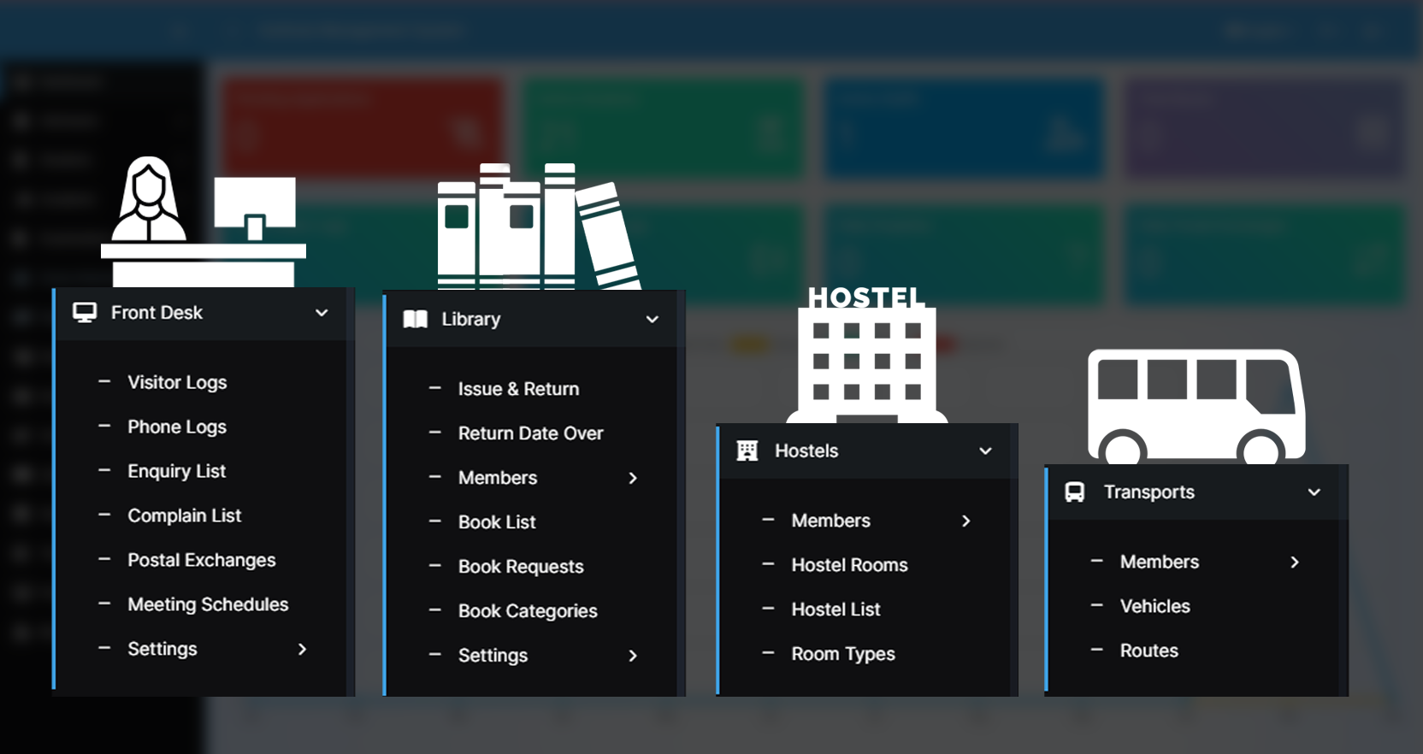
Discover a spectrum of options for personalized
Library, Transport, Hostel, and Front Desk management.

Slide 18


